Slide 1
Deep Leaning 을 이용한 숫자 인식 알고리즘 성능 분석
201701313 남영우
지도교수: 유용석

Slide 2
Content
Introduction
Dataset
Image Processing
Model
What I learned?
Reference
Discussion

Slide 3
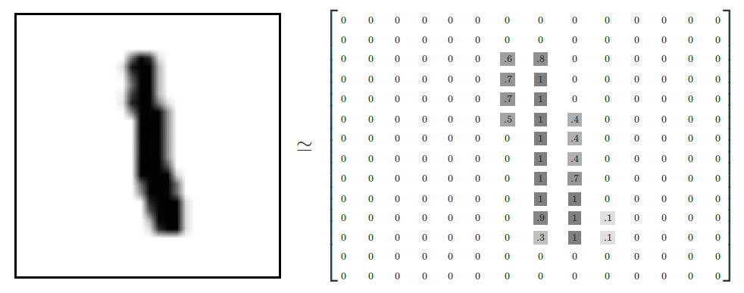
Introduction
Human can recognize this picture expressed digit 1
But computer has no idea about this picture.
Then, How can Computer recognize this picture to digit 1?

Slide 4
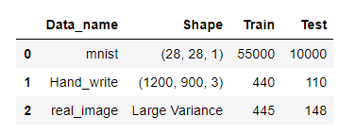
Dataset
1.mnist data
http://yann.lecun.com/exdb/mnist/
2.IAM hand writing set
http://www.fki.inf.unibe.ch/databases/iam-handwriting-database
3.the chars74K dataset
http://www.ee.surrey.ac.uk/CVSSP/demos/chars74k/

Slide 5
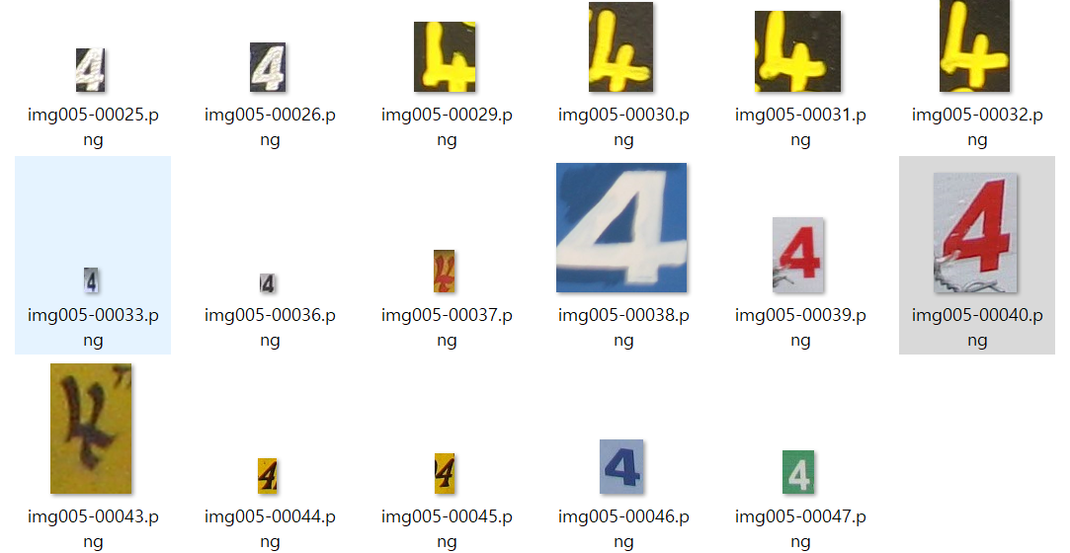
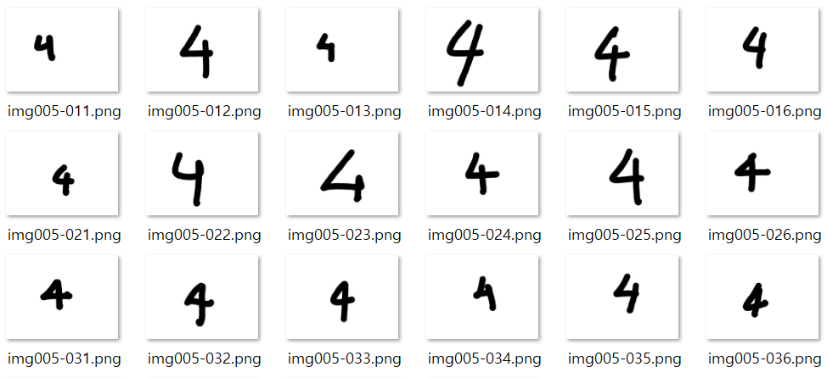
Dataset
The 74k Chars data
IAM Hand Writing Data

Slide 6
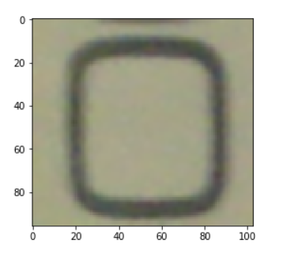
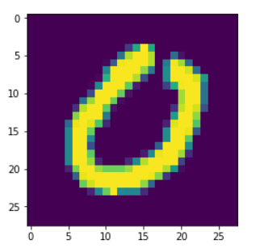
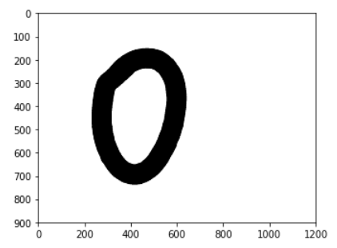
[Pre-processing] Goal, Gaussian Blur
The 74k Chars mnist
IAM Hand Writing Data

Slide 7
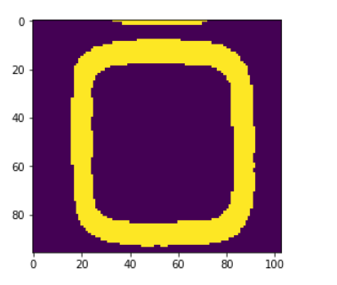
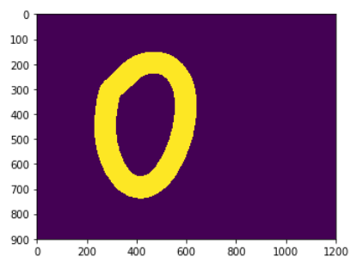
[Pre-processing] Convert to gray
The 74k Chars
IAM Hand Writing Data

Slide 8
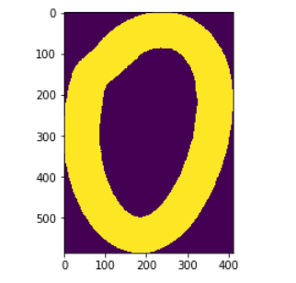
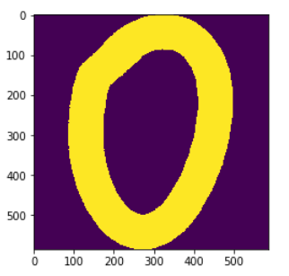
[Pre-processing] ROI, Adjust Frame
IAM-ROI extraction
IAM-Adjust Frame

Slide 9
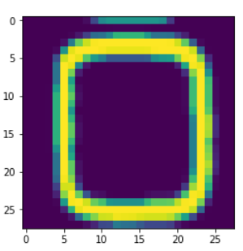
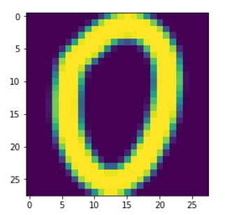
[Pre-processing] Resize and Downsampling
The 74k Chars Mnist
IAM Hand Writing Data
Final shape (784)

Slide 10
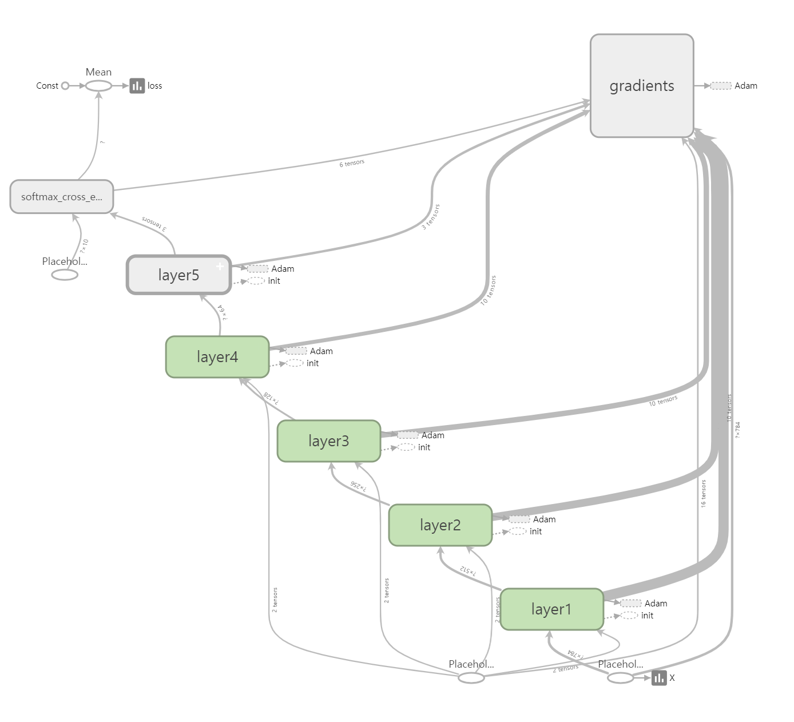
Model
First data shape = 784(28 * 28)
(image shape)
Layer 1 data shape = 512
Layer 2 data shape = 256
Layer 3 data shape = 128
Layer 4 data shape = 64
Layer 5 data shape = 10
(Label shape)
Number of layers :5
Optimize algorithm: Adam optimizer
Check accuracy: softmax cross entropy

Slide 11
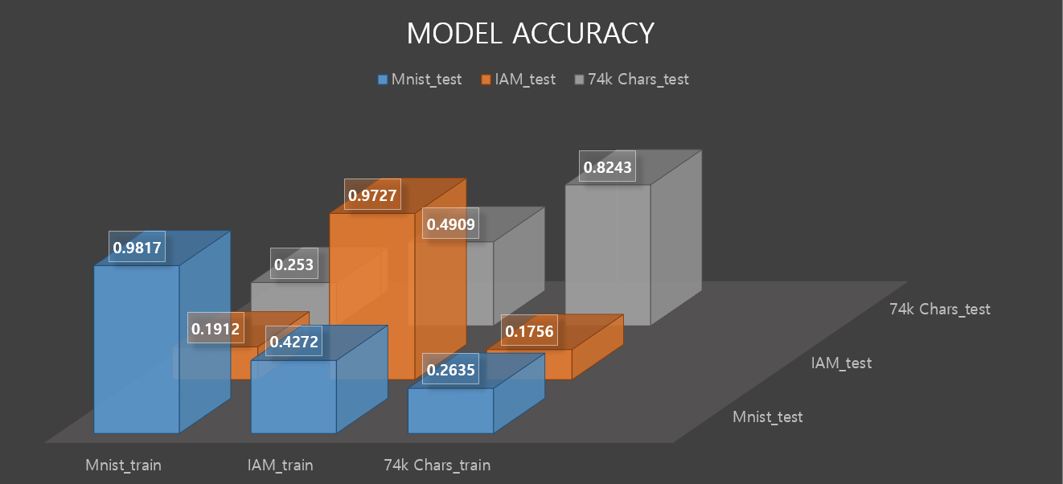
Prediction Accuracy

Slide 12
What I learned?
How to process image
-Difference about array’s size and shape
-Image process libraries (ex. Opencv2, PIL, numpy, matplotlib…)
-Read many Images in python and make dataset
Difficulty of making General Model

Slide 13
Reference
Sung Kim- Tensorboard codes
https://github.com/hunkim
Mnist data
http://yann.lecun.com/exdb/mnist/
IAM hand writing set
http://www.fki.inf.unibe.ch/databases/iam-handwriting-database
the chars74K dataset
http://www.ee.surrey.ac.uk/CVSSP/demos/chars74k/
Professor Yongseok Yoo – Advisor
https://github.com/ys7yoo

Slide 14


Slide 15
Q / A

